Slide 1
Graph Search

Slide 2
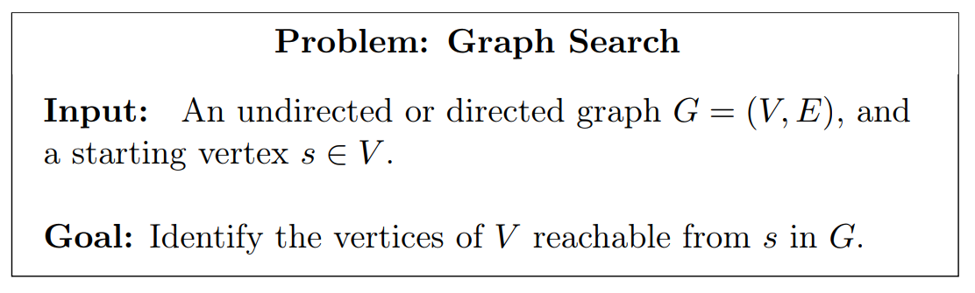

Slide 3
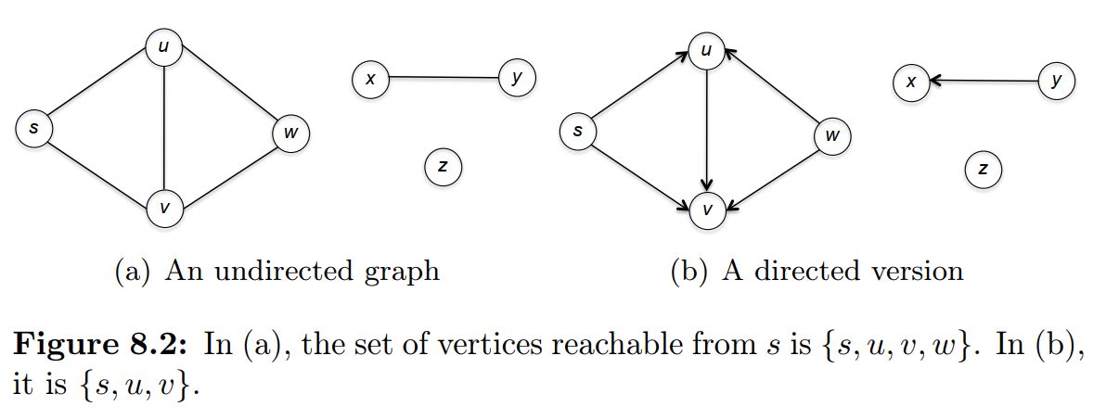

Slide 4
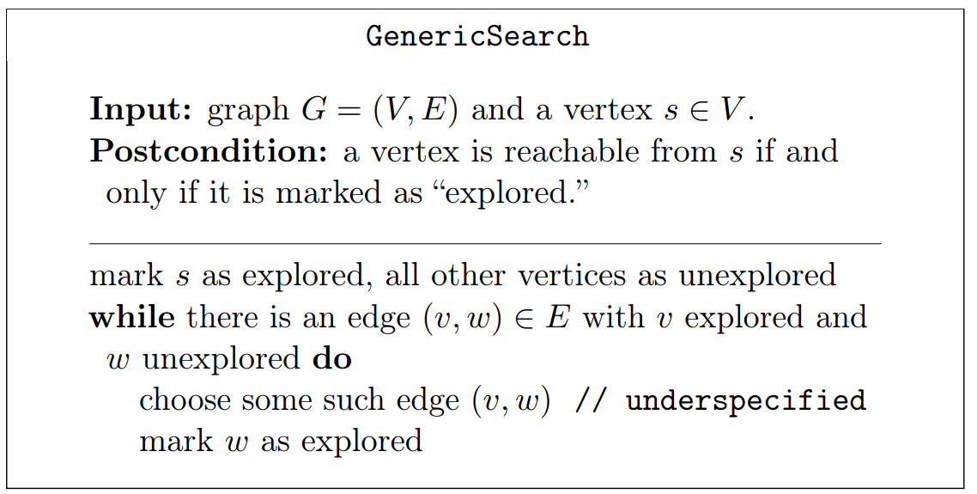

Slide 5
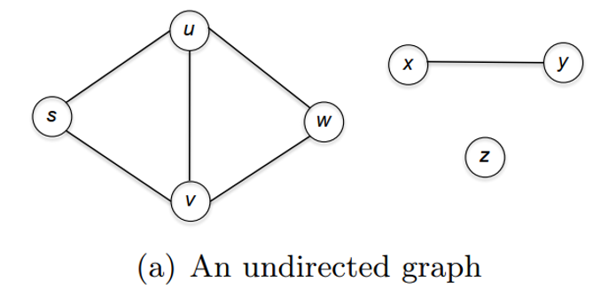
1) initially only “starting vertex” s is marked as explored.
2) In the first iteration of the while loop,
two edges meet the loop condition: (s, u) and (s, v).
3) The GenericSearch algorithm chooses one of these edges—(s, u), say—and marks u as explored.
4) In the second iteration of the loop,
there are 2 choices: (s, v) and (u, w).
5) The algorithm might choose (u, w), in which case w is marked as explored.
6) With one more iteration (after choosing either (s, v) or (w, v)), v is marked as explored.
7) At this point, the edge (x, y) has two unexplored endpoints
the other edges have two explored endpoints, and the algorithm halts.
the vertices marked as explored—s, u, v, and w—are precisely the vertices reachable from s.
Notes:
Importance!!
For graph search question, a “starting vertex” is required as an input parameter <- our starting point.

Slide 6
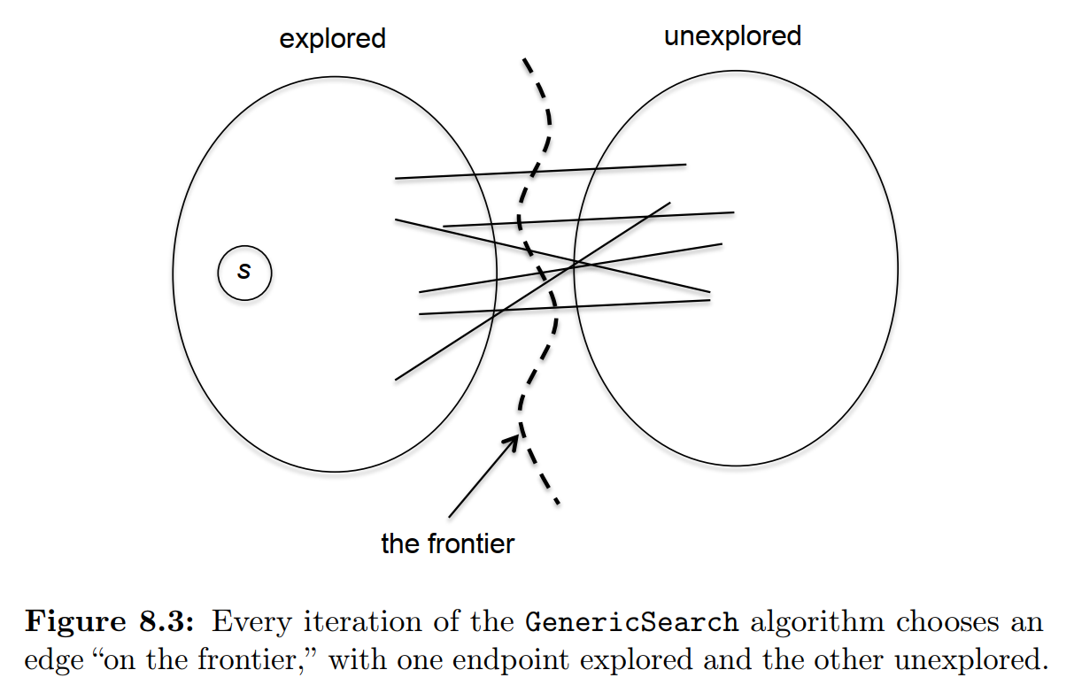

Slide 7

Breadth-first search and depth-first search
At step 4), you have 2 choices
-> (s, v) or (u, w)
Breadth-first search will choose (s, v)
depth-first search will choose (u, w)

Slide 8
Breadth-first Search (BFS)
explore the vertices of a graph cautiously, in “layers.”
Layer 0 consists only of the starting vertex s and nothing else.
Layer 1 is the set of vertices that are one hop away from s—that is, s’s neighbors.
Layer 2 comprises the neighbors of layer-1 vertices that do not belong to layer 0 or 1
and so on.

Slide 9
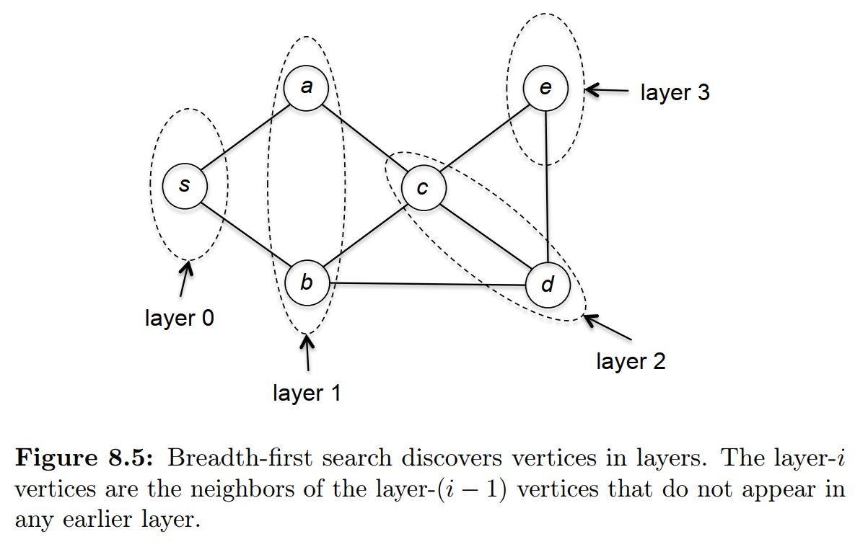

Slide 10
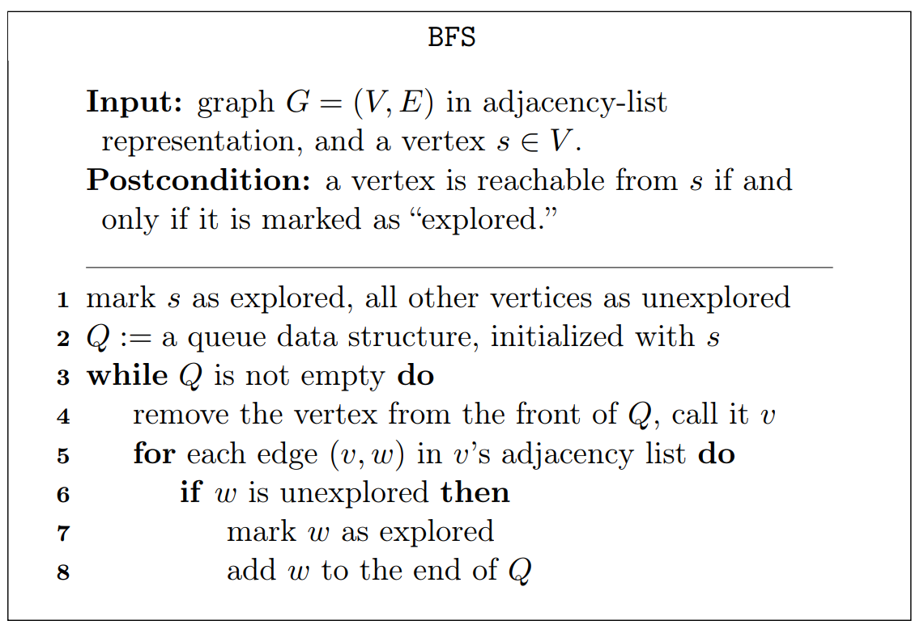
BFS uses Queue
BFS uses a queue to keep track of which vertices to explore next.
Notes:
Each iteration of the while loop explores one new vertex. BFS iterates through all the edges from vertex v.
Unexplored neighbors of v are added to the end of the queue and are marked as explored; they will eventually be processed in later iterations of the algorithm.

Slide 11
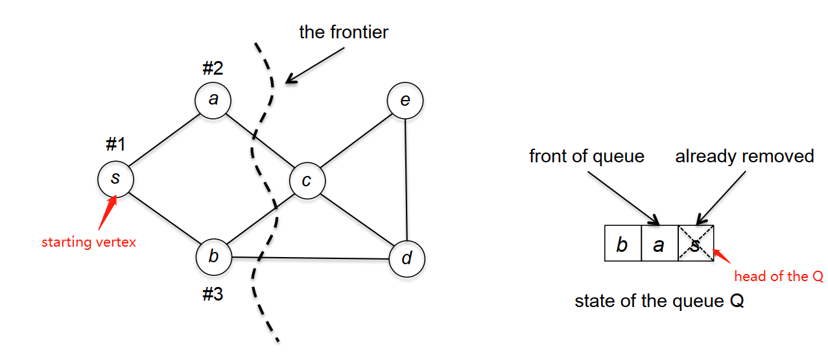
BFS Example
1) The starting vertex s is always the first to be explored.
2) The first iteration of the while loop extracts s from the queue Q and the subsequent for loop examines the edges (s, a) and (s, b)
3) Because neither a nor b is marked as explored, both get inserted into the queue.
Let’s say that edge (s, a) came first and so a is inserted before b.

Slide 12
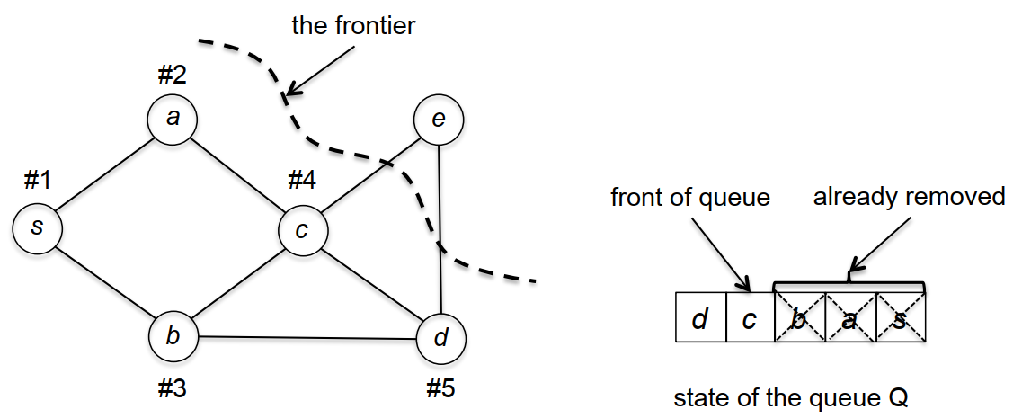
1) The next iteration of the while loop extracts the vertex a from the front of the queue,
and considers its edges (s, a) and (a, c).
2) It skips over s because s is already marked as explored / visited,
and adds the vertex c (unexplored / unvisited) to the end of the queue.
3) The third iteration extracts the vertex b from the front of the queue and adds vertex d to the end (because s and c are already marked as explored, they are skipped over).

